Slide 1
Digital Image Processing UNIT-II Spatial Filters

Slide 2
Image Enhancement-Domains
Objective – process an image so that the result is more suitable than the original image for a specific application.
There are mainly two methods for image-enhancement: one deals with images in the spatial domain, the other one deals with images in the frequency domain. The ﬁrst method is based on the processing of individual pixels in an image, the second is based on modifying the Fourier transform of an image.

Slide 3
Image Enhancement

Slide 4
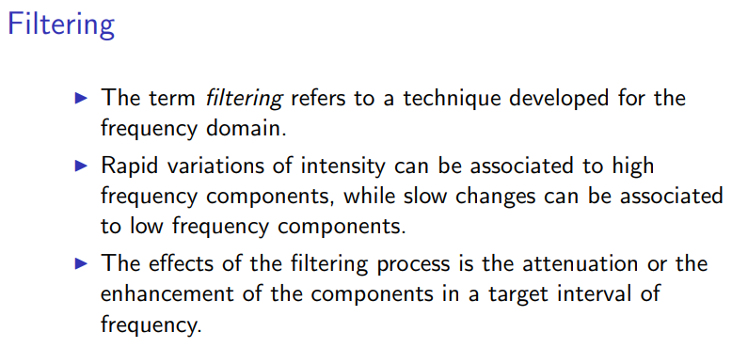

Slide 5
Spatial Filters
Spatial Filtering technique is used directly on pixels of an image. Mask is usually considered to be added in size so that it has specific center pixel. This mask is moved on the image such that the center of the mask traverses all image pixels.
Filters in frequency domain:
Lowpass filter that passes low frequencies: used for smoothing (blurring) on the image.
High pass filter that passes high frequencies: used for sharpening the image.
Bandpass filter.
Filters in spatial domain:
Spatial filters used different masks (kemels, templates or windows).
There is a one-to-one correspondence between linear spatial filters and filters in frequency domains.
Spatial filters can be used for linear and nonlinear filtering. (Frequency domain filters just for linear filtering).
The mechanics of spatial filtering spatial filters consists of:
Neighbourhood (small rectangle).
Predefined operation that is performed on the image pixel.

Slide 6
Spatial Filters Classification
Classification on the basis of linearity: There are two types:
Linear Spatial Filter
Non-linear Spatial Filter
General Classification:
Smoothing Spatial Filter: It is also called lowpass filters. Smoothing filter is used for blurring and noise reduction in the image. Blurring is pre-processing steps for removal of small details and Noise Reduction is accomplished by blurring.
Types of Smoothing Spatial Filter:
Linear Filter (Mean Filter)
Order Statistics (Non-linear) filter
Sharpening Spatial Filters: It is also called high pass filters. For example, the Laplacian linear filter.

Slide 7
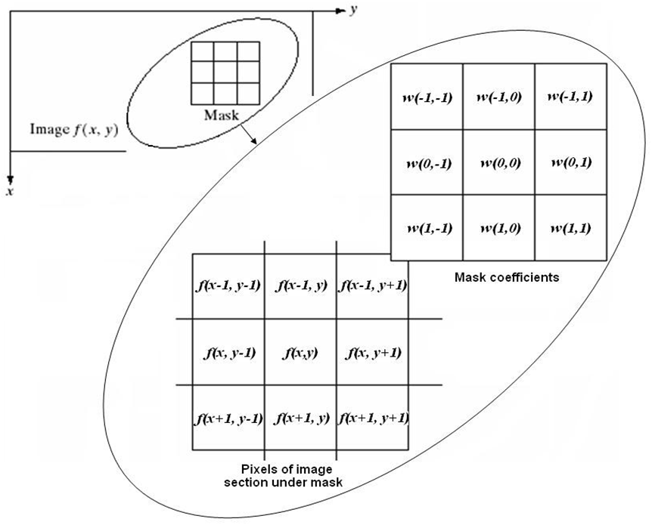
Mechanism :
Filtering creates new pixel with coordinates equal to the coordinates of the centre of the neighbourhood, and whose value is the result of the filtering operation.
If the operation performed on the image pixel is linear, then the filter is called a linear spatial filter, otherwise, the filter is nonlinear.
Figure 1 presents the mechanics of linear spatial filtering using a 3*3 neighborhood.
the response (output) g(x, y) of the filter at any point (x, y) in the image is the sum of products of the filter coefficients and the image pixels values:

Slide 8
Linear Spatial Filtering (Convolution)
The process consists of moving the filter mask from pixel to pixel in an image. At each pixel (x,y), the response is given by a sum of products of the filter coefficients and the corresponding image pixels in the area spanned by the filter mask.
For the 3×3 mask shown in the previous figure, the result (or response), R, of linear filtering is:
𝑅 = w(−1, −1)ƒ(𝑥 − 1, 𝑦 − 1) + w(−1,0)ƒ(𝑥 − 1, 𝑦) + ⋯
+w(0,0)ƒ(𝑥, 𝑦) + ⋯ + w(1,0)ƒ(𝑥 + 1, 𝑦) + w(1,1)ƒ(𝑥 + 1, 𝑦 + 1)
In general, linear filtering of an image f of size M×N with a filter mask of size m×n is given by the expression:
𝑎 𝑏
𝑔(𝑥, 𝑦) = ∑ ∑ w(𝑠, 𝑡)ƒ(𝑥 + 𝑠, 𝑦 + 𝑡)
𝑠=−𝑎 𝑡=−𝑏
where a = (m - 1)/2 and b = (n - l)/2. To generate a complete filtered image this equation must be applied for x = 0,1, 2,..., M-1 and y = 0,1, 2,..., N-1.

Slide 9
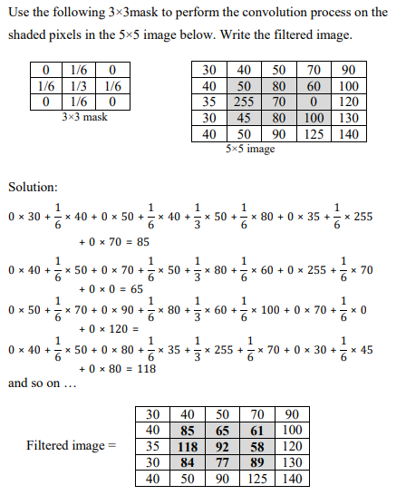
Example

Slide 10
Nonlinear Spatial Filtering
The operation also consists of moving the filter mask from pixel to pixel in an image. The filtering operation is based conditionally on the values of the pixels in the neighborhood, and they do not explicitly use coefficients in the sum-of-products manner.
For example, noise reduction can be achieved effectively with a nonlinear filter whose basic function is to compute the median gray-level value in the neighborhood in which the filter is located. Computation of the median is a nonlinear operation.

Slide 11
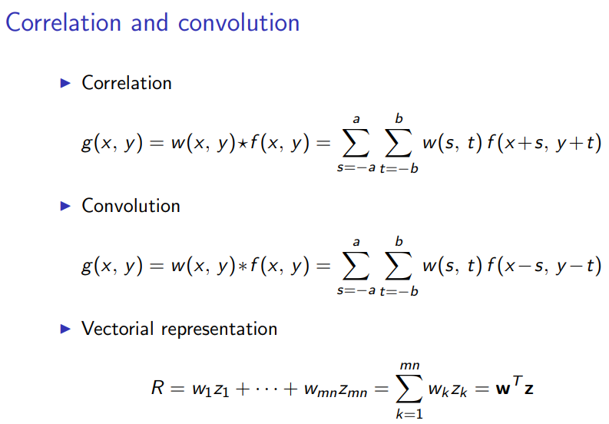
Spatial Correlation and convolution
Correlation: the process of moving a filter mask over the image and computing the sum of products at each location.
Convolution: the same process as correlation, except that the filter is first rotated by 180 degrees

Slide 12
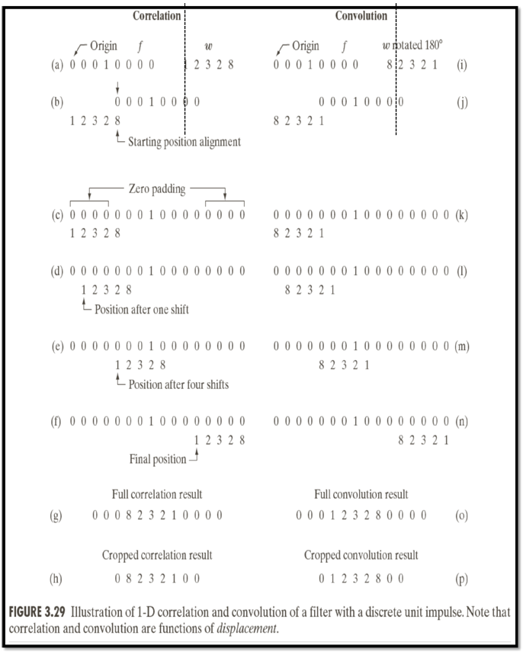
Spatial Correlation and convolution
Example: 1-D illustration: (figure 2)
Assume that f is a 1-D function, and w is a filter

Slide 13
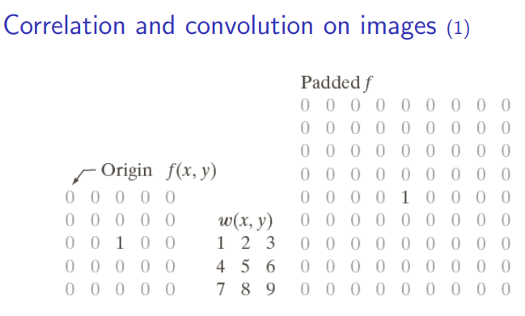
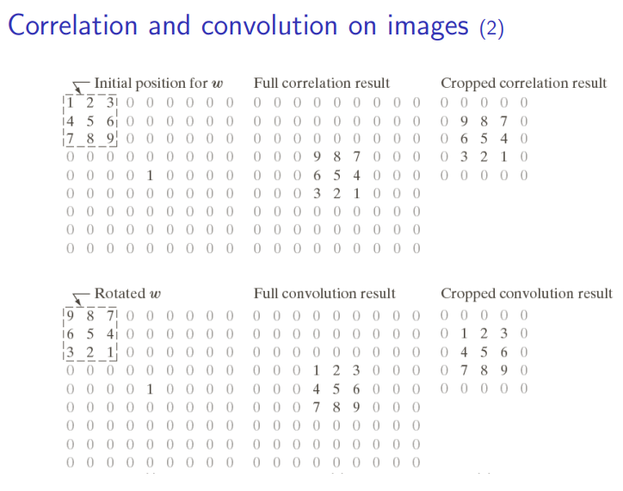

Slide 14
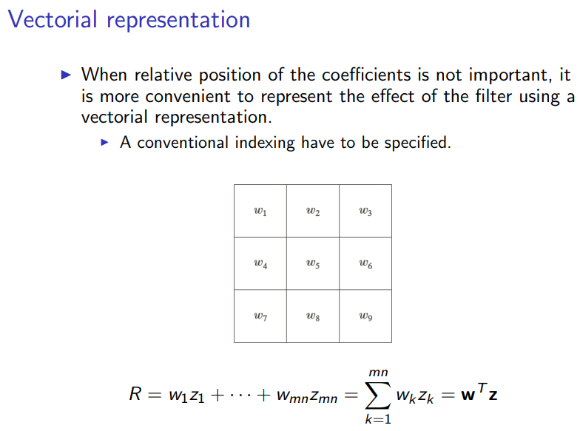

Slide 15
Smoothing Spatial Filters
Types of Smoothing Spatial Filter:
Linear Filter (Mean Filter)
2. Order Statistics (Non-linear) filter
Linear Filter(Mean Filter): Linear spatial filter is simply the average of the pixels contained in the neighborhood of the filter mask. The idea is replacing the value of every pixel in an image by the average of the grey levels in the neighbourhood define by the filter mask.
Types of Mean filter:
(i) Averaging filter: It is used in reduction of the detail in image. All coefficients are equal.
(ii) Weighted averaging filter: In this, pixels are multiplied by different coefficients. Center pixel is multiplied by a higher value than average filter.

Slide 16
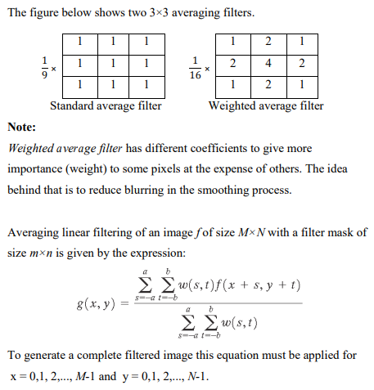
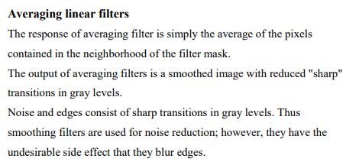
Linear Filter ( Mean Filter)

Slide 17
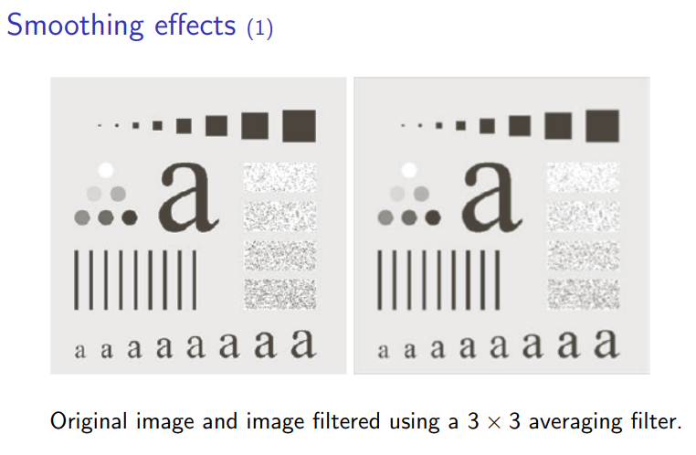
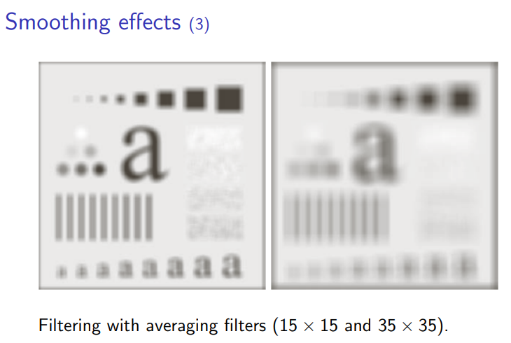
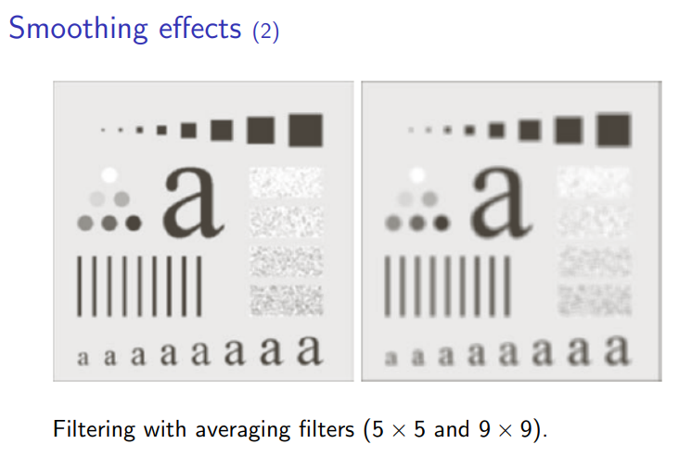
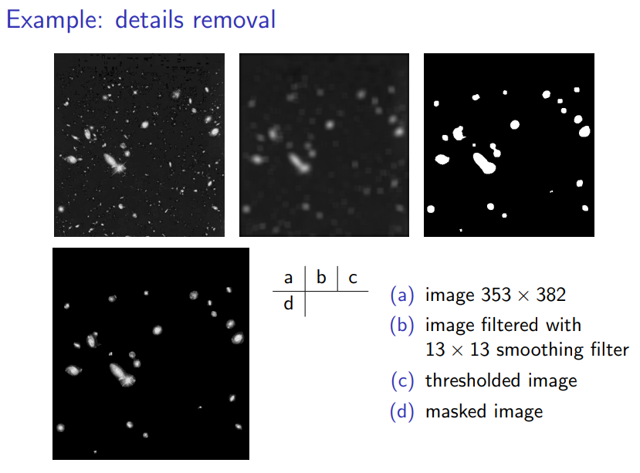

Slide 18
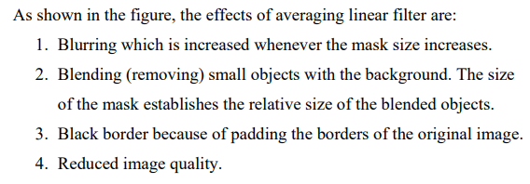
Effects Averaging filter

Slide 19
Order-statistics filters ( Non-Linear filter)
It is based on the ordering the pixels contained in the image area encompassed by the filter. It replaces the value of the center pixel with the value determined by the ranking result. Edges are better preserved in this filtering.
Types of Order statistics filter:
(i) Minimum filter: 0th percentile filter is the minimum filter. The value of the center is replaced by the smallest value in the window.
(ii) Maximum filter: 100th percentile filter is the maximum filter. The value of the center is replaced by the largest value in the window.
(iii) Median filter: Each pixel in the image is considered. First neighboring pixels are sorted and original values of the pixel is replaced by the median of the list.

Slide 20
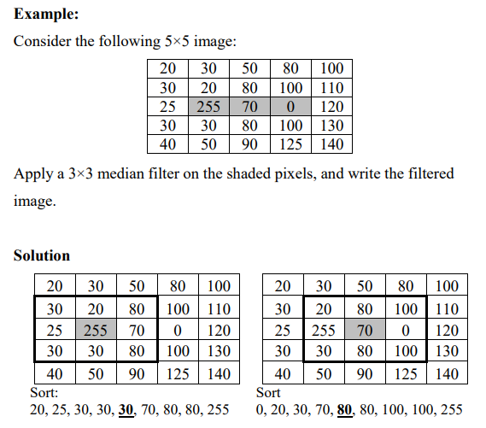
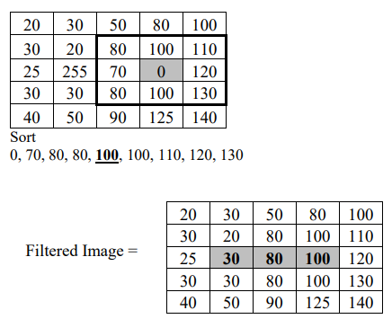
As shown in the figure, the effects of median filter are:
Noise reduction
Less blurring than averaging linear filter

Slide 21
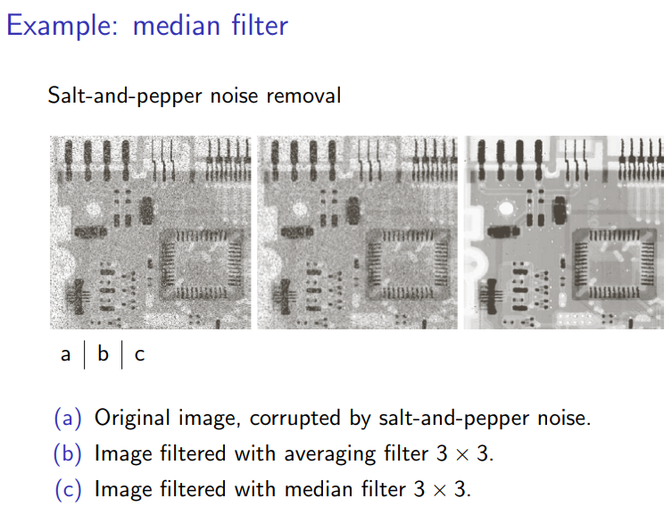

Slide 22
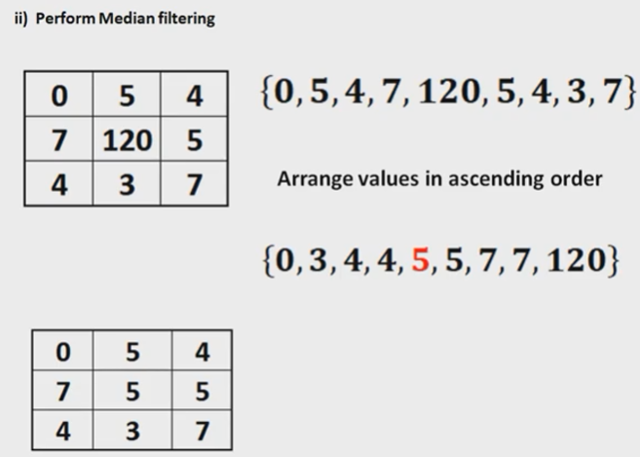
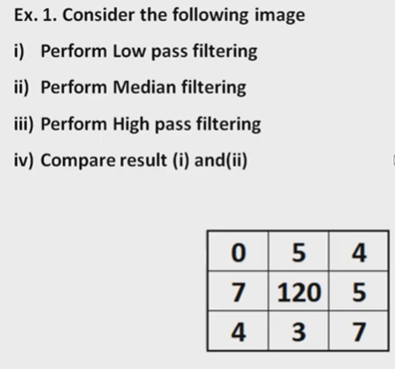
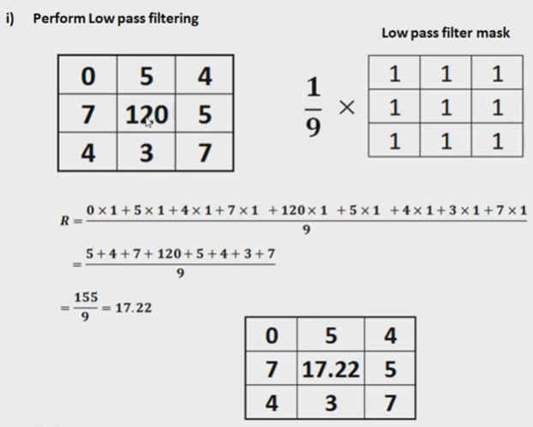
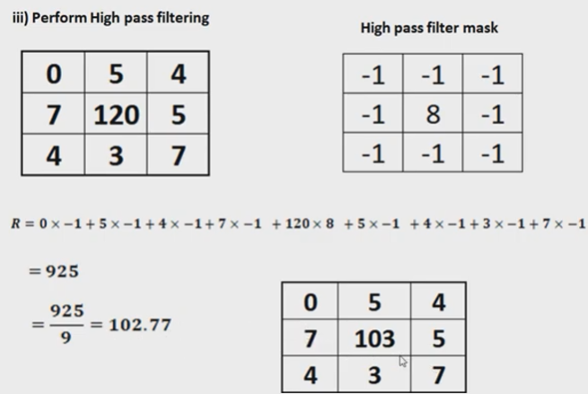
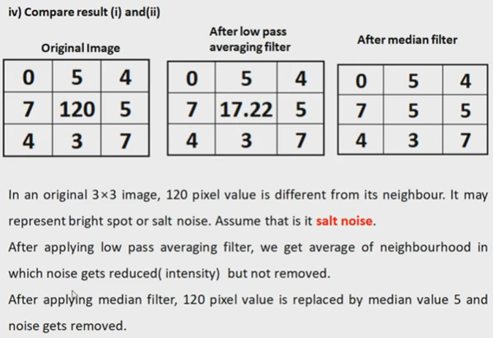

Slide 23
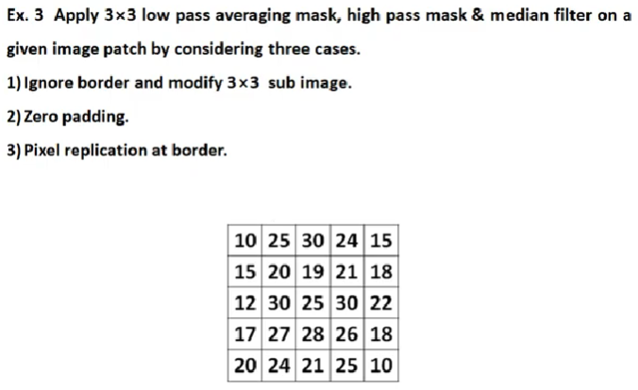
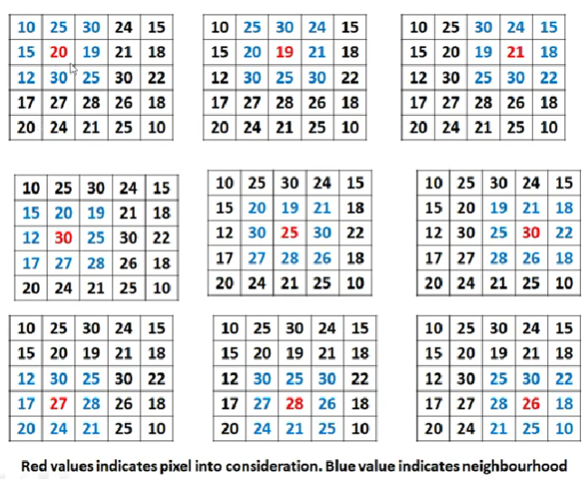
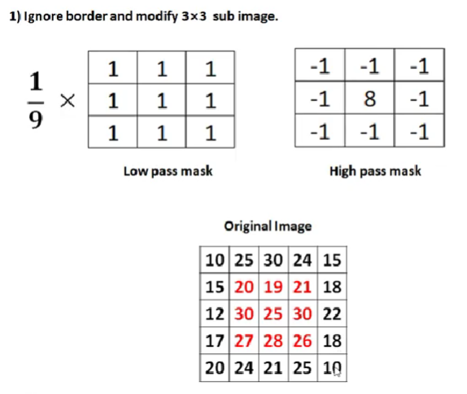

Slide 24
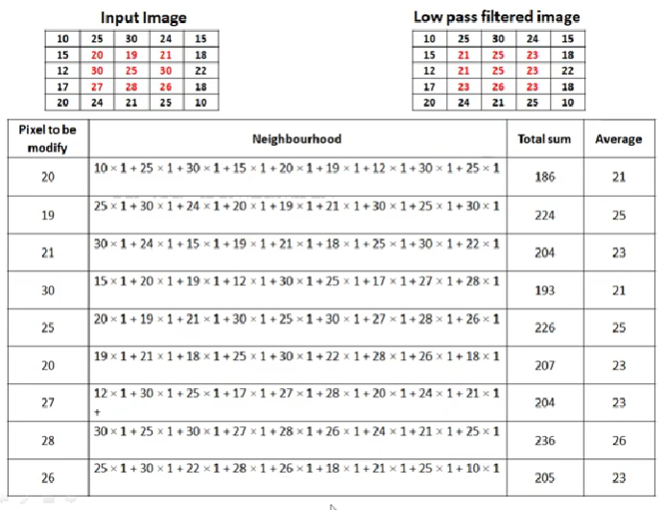
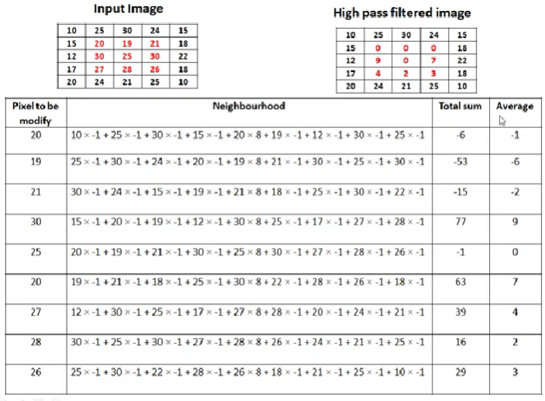

Slide 25
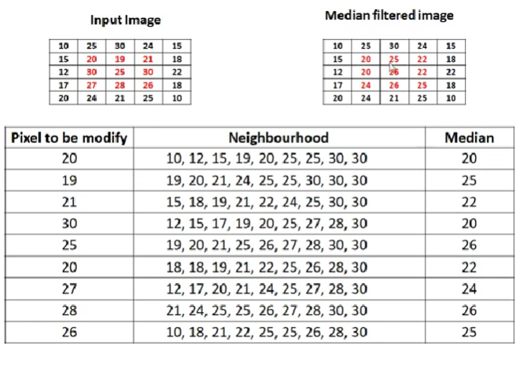
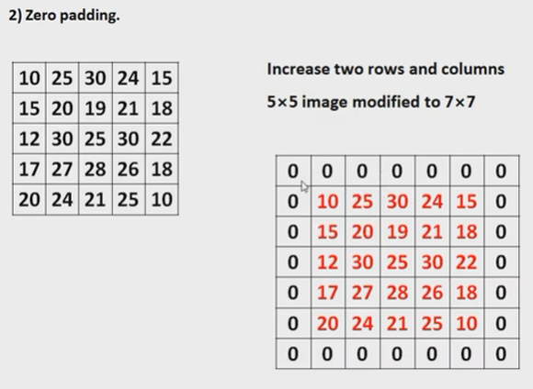
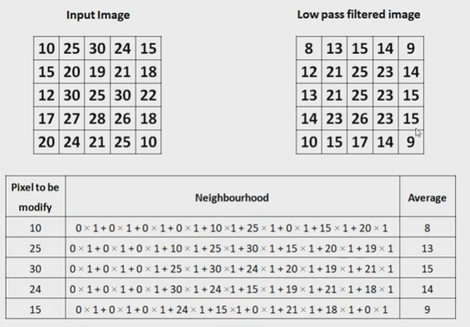
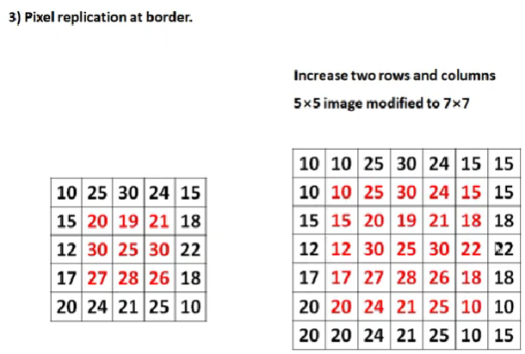
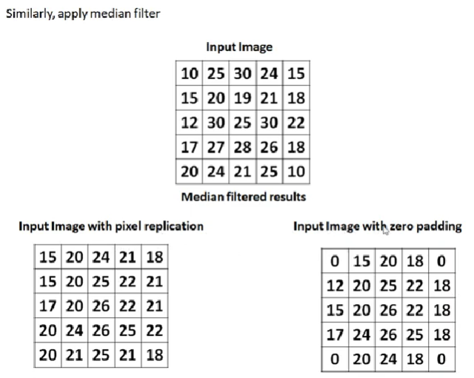
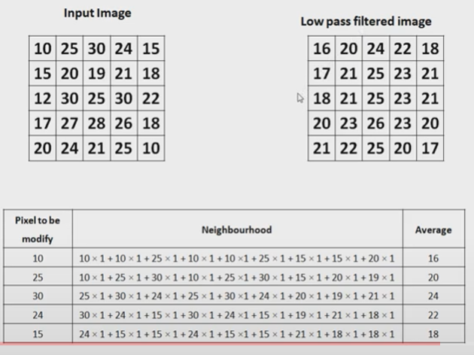

Slide 26
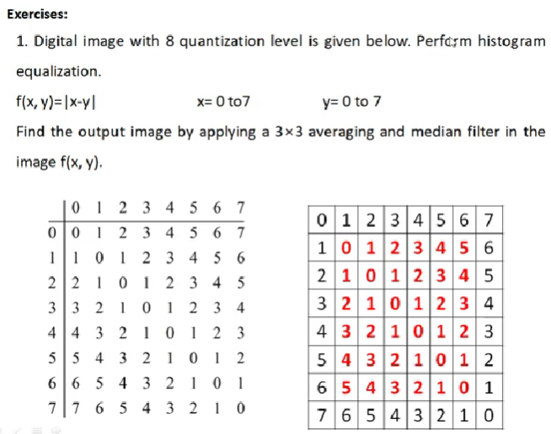
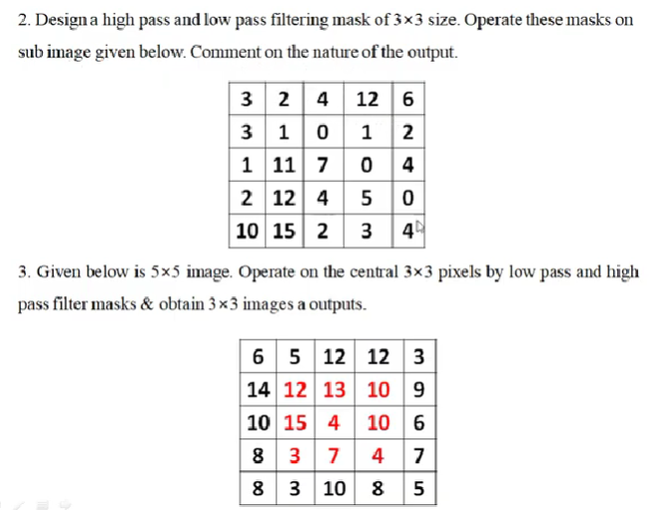
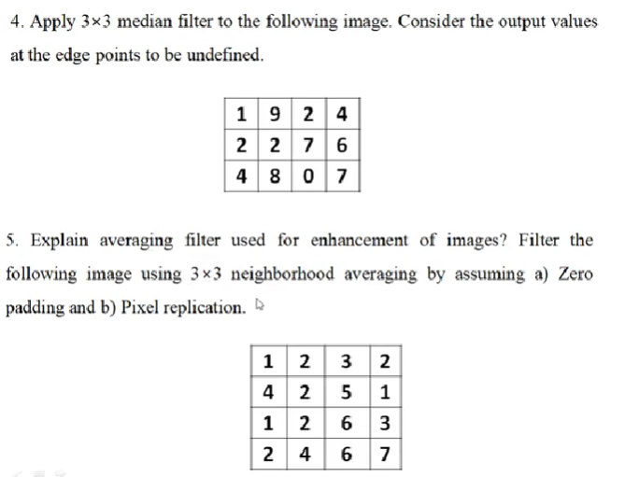

Slide 27
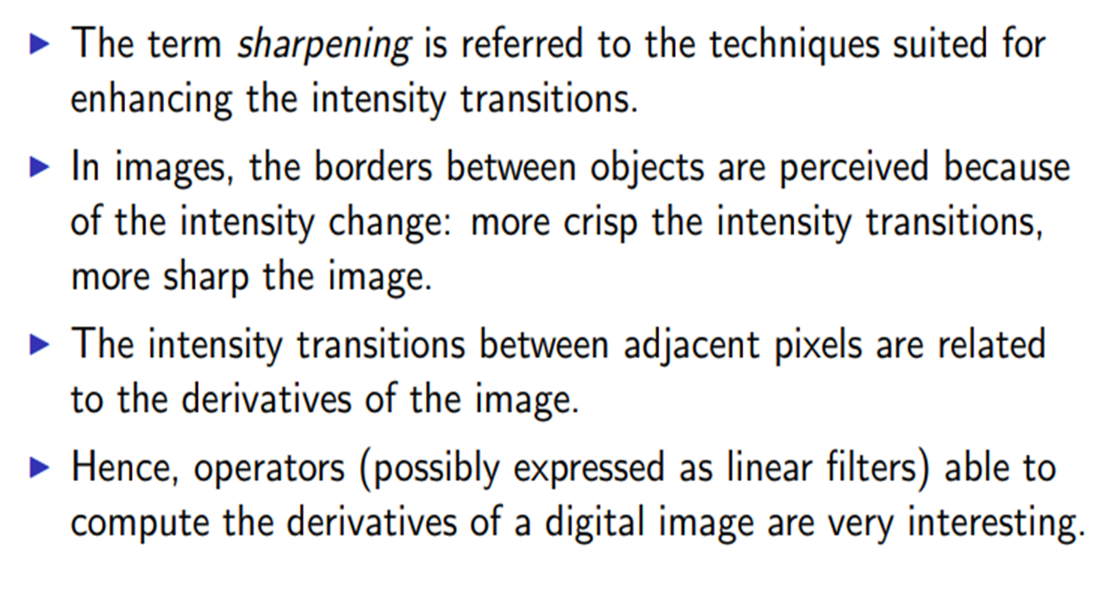
Sharpening Spatial Filters
It is also known as derivative filter. The purpose of the sharpening spatial filter is just the opposite of the smoothing spatial filter.
Its main focus in on the removal of blurring and highlight the edges. It is based on the first and second order derivative.

Slide 28
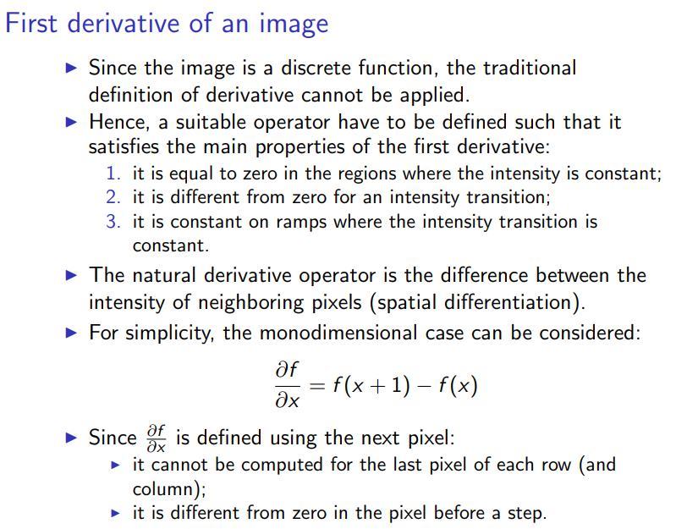

Slide 29
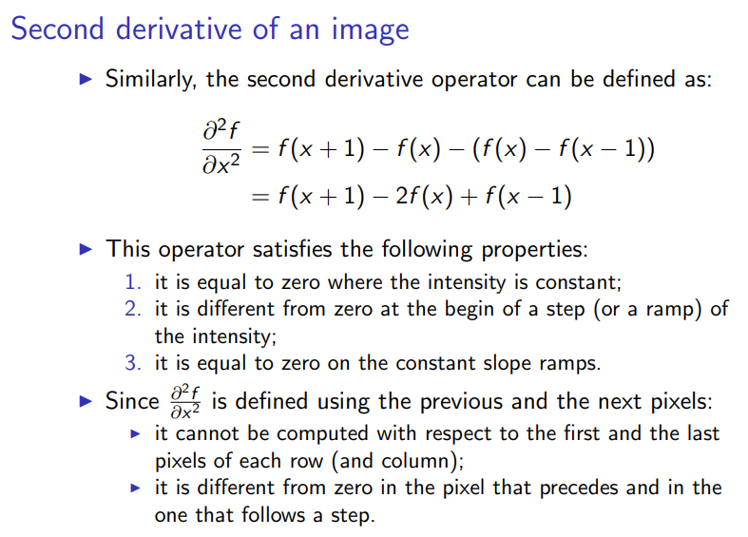

Slide 30
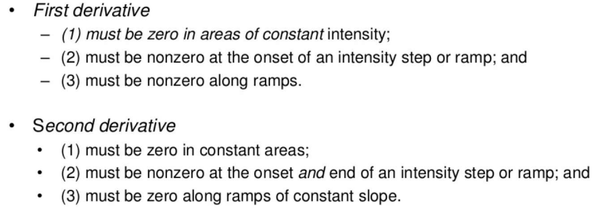
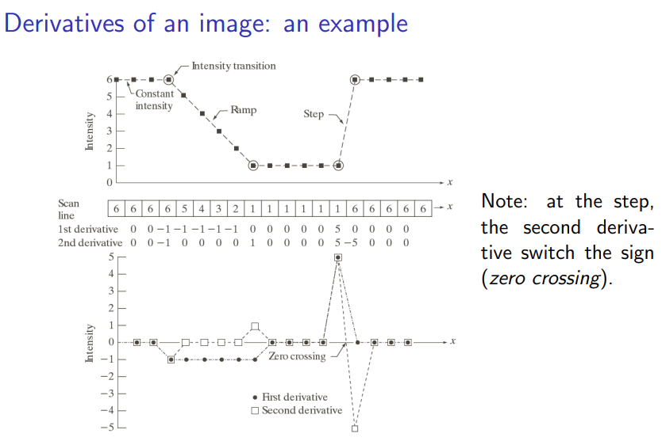

Slide 31
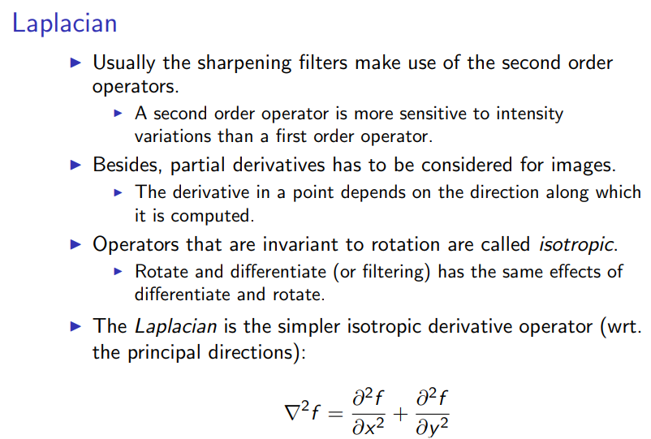

Slide 32
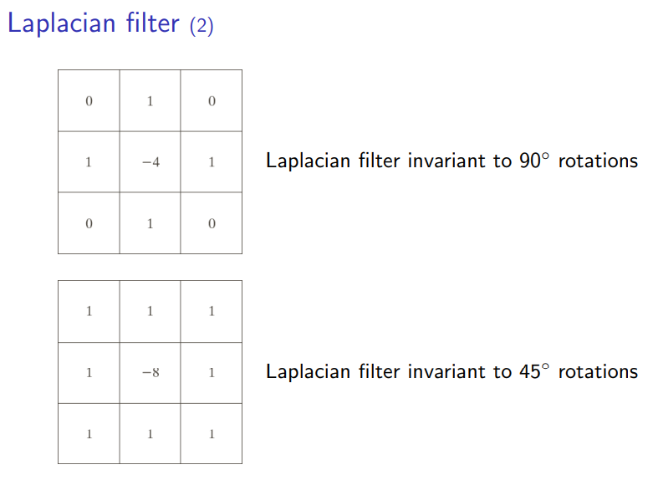
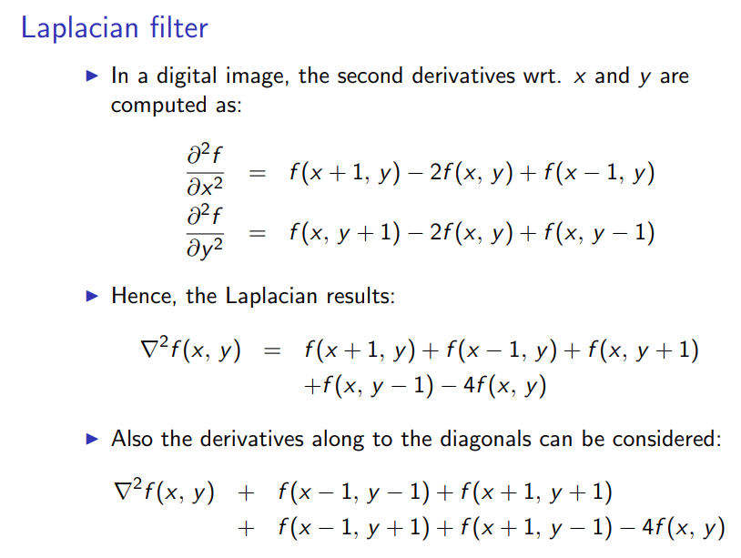
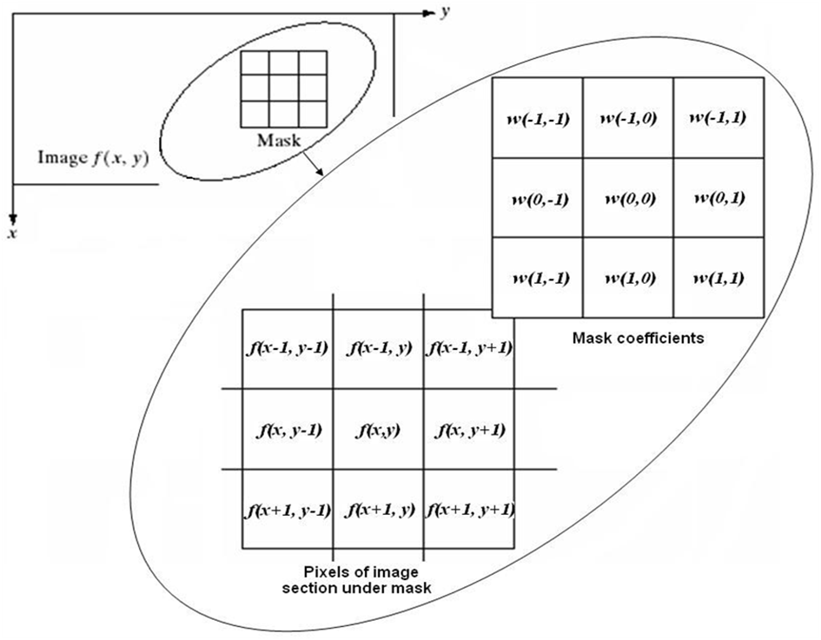

Slide 33
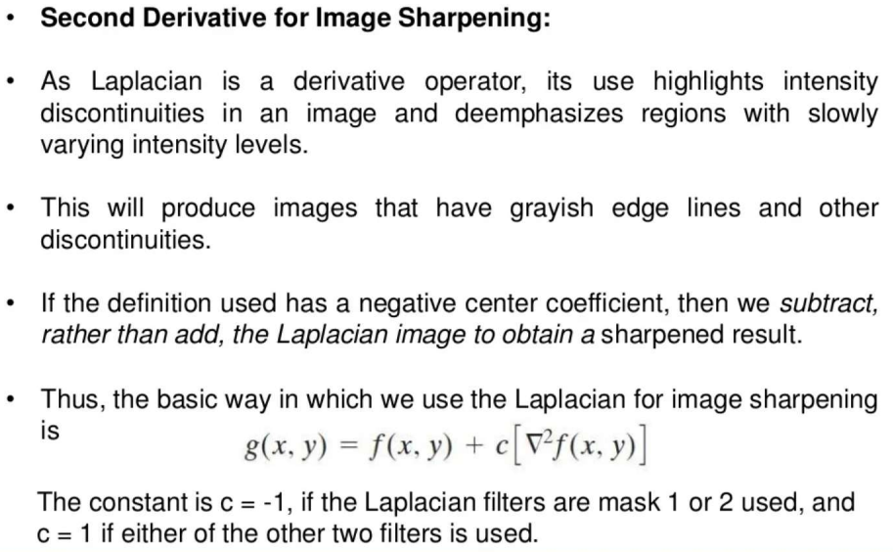

Slide 34
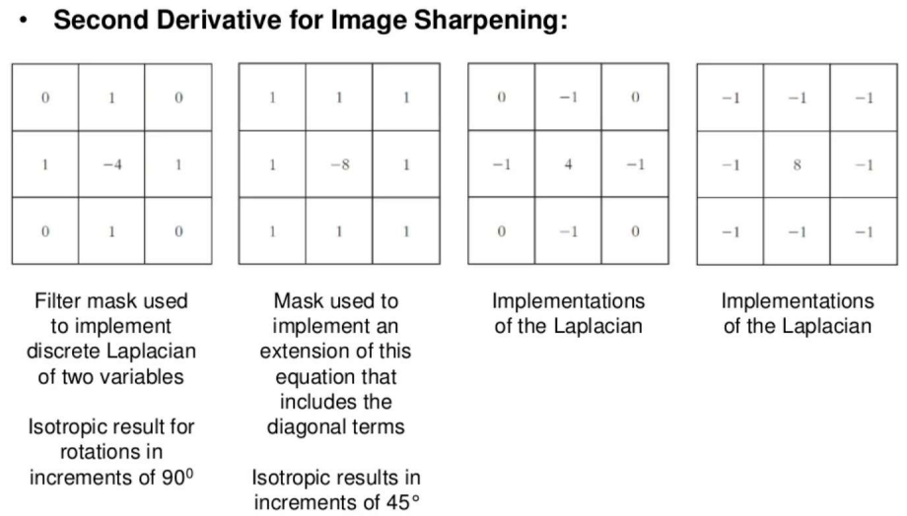

Slide 35
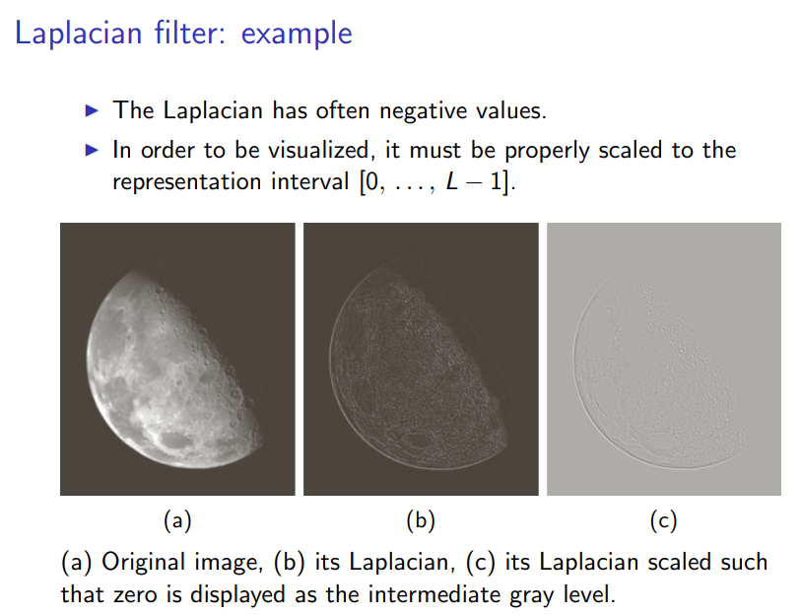
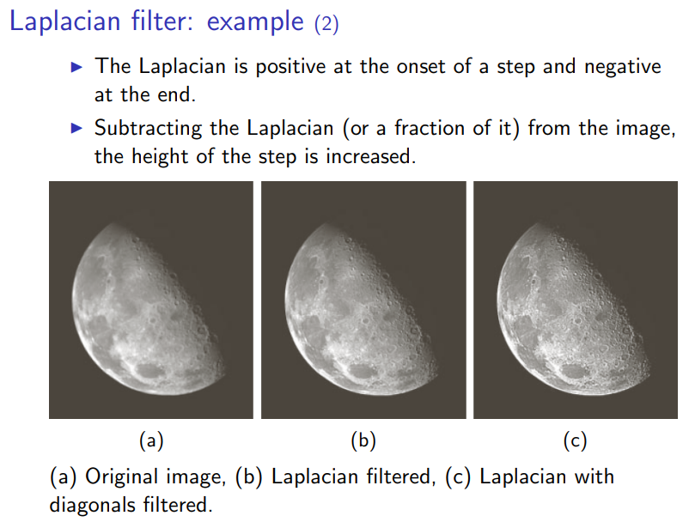

Slide 36




Slide 37



Slide 38



Slide 39



Slide 40



Slide 41



Slide 42



Slide 43


Histogram

